Slide 1
Visualizing Data for Libraries
Mahogany Elven Lore, Rutgers University
December 2018

Slide 2
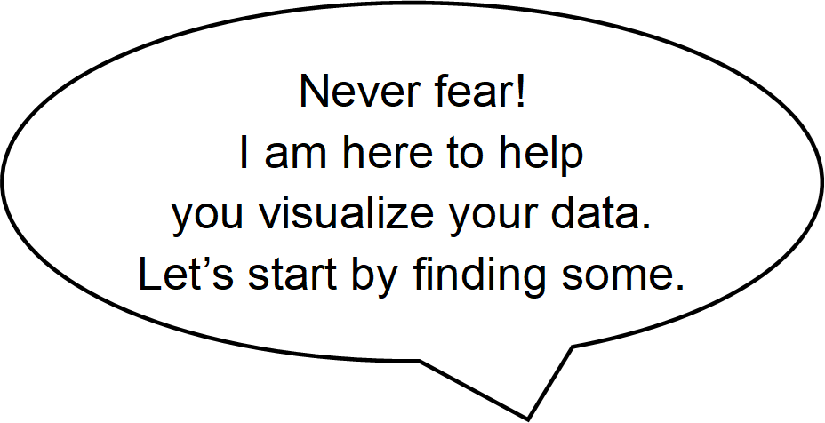
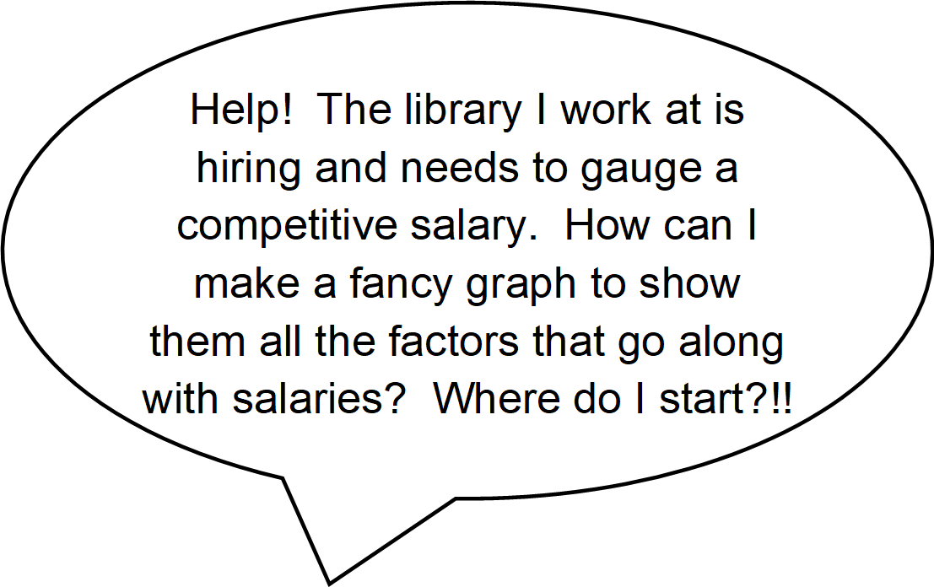
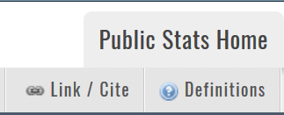
Acquire Data
Locate & Browse Data
Library Research Service: Data & Tools>>Public Libraries>>Colorado Public Library Statistics and Profiles from menu. Go to Survey Data from the Public Library Annual Report Data (1987 – present) section.
Inspect the Definitions in the data menu bar to determine which fields you want to use.
Select Data
From the Advanced tab in the Refine Results pane select one year at a time.
Click the +/- sign next to each data field group header of interest to expand/collapse the fields. Check the boxes next to the data fields you selected from the definitions, and scroll to the bottom and hit Submit.
Alternatively, hit the data menu bar Master File option to export all the data for the current year in CSV format.

Slide 3
Acquire Data (cont’d)
Browse under Data & Tools.
Export Data
Hit the data menu bar option with the Export results below in .csv format tooltip.
Name and save the CSV file in your data directory.
Select the next year from the Advanced tab in the Refine Results pane, Submit, and repeat until you have exported all the years of data you want.

Slide 4
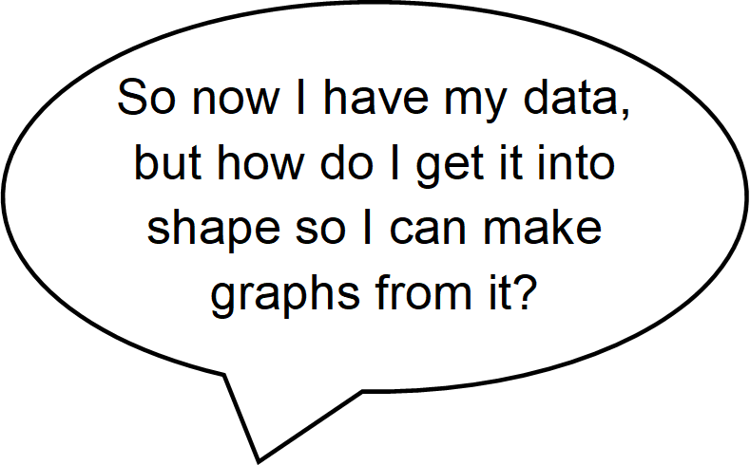
Prepare Data Excel
Setup Spreadsheet
Create and save a new Excel spreadsheet.*
Open the first CSV file, copy the data minus the file headers and footers, and paste it into the second column of your spreadsheet.
Delete the year row.
Fill in Data
Type Year in the first column header, and fill the dataset’s year in the first column to the last row of that year’s data.
Repeat for each of the remaining CSV files, but do not copy the data headers.
*These instructions are for Office 365.

Slide 5
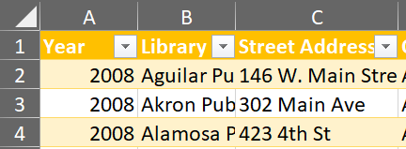
Prepare Data Excel (cont’d)
Browse under Data & Tools.
Format Data View
Select all your data and apply Format as Table to make it easier to sort and filter.
Rearrange columns to bring fields you will be visualizing now to the beginning of the spreadsheet using Cut and Insert Cut Cells.
Edit Data
Rename the data worksheet, create a new one with a color coded key to identify types of edits, and apply those colors as you edit.
Sort columns to easily identify missing data.
Copy values from appropriate cells and paste to cells with empty or 0 values (for example, from available low salaries to missing high salaries and vice versa).

Slide 6
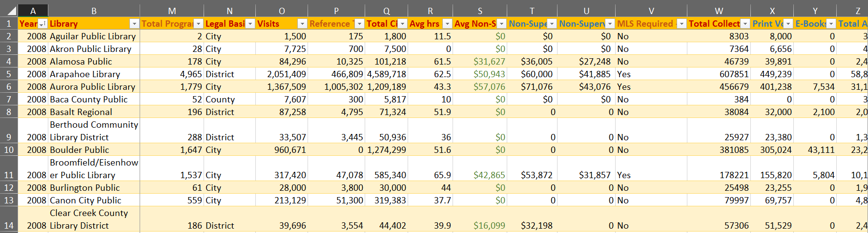
Prepare Data Excel (cont’d)
Browse under Data & Tools.
Aggregate Data
Insert a column next to fields you want to aggregate.
Type =SUM( to add cells or =AVERAGE( to average them, and then select and drag the cells you wish to aggregate. Close the parentheses with ) and then hit enter. Apply the pattern to the rest of the column if Excel does not automatically.
Finished View

Slide 7
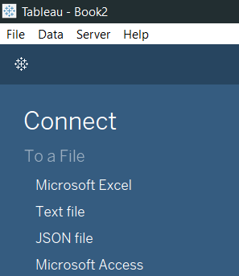
Prepare Data Tableau
Browse under Data & Tools.
Connect Tableau to Spreadsheet
From the left pane connect to a Microsoft Excel file, browse to, and select the Excel file you created. Hit the Open button.
Drag the worksheet containing the data to the right-side window.
Pivot Data
In order to create visualizations like pie charts which show, for example, how many of each type of collection were in the whole of the collection, the columns must be pivoted from those which give a count for each type in its own column to a set of two columns, one for the count and one for the collection type.
Select the columns in question , click on the arrow to the top right of the column header and choose Pivot.
The pivoted columns are now at the end. Rename them to easily identify them.
*These instructions are for Tableau 2018.2.0.

Slide 8
Prepare Data Tableau (cont’d)
Browse under Data & Tools.
Configure Data Grouping
Organize the data view to make your work more efficient by grouping fields before starting your visualization.
Select any field and right click or click on the arrow to the right to select Group by>>Folder.
Organize Data View
Select the fields to group, right click, and choose Folders>>Create Folder.
Name the folder and hit OK.
Save, and you are ready to start visualizing.
Finished View

Slide 9
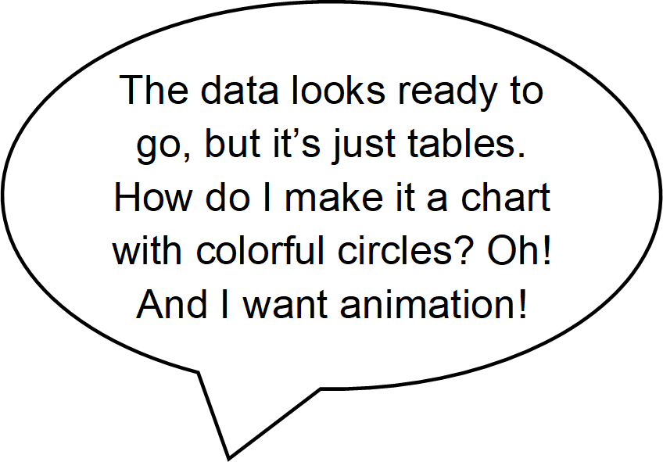
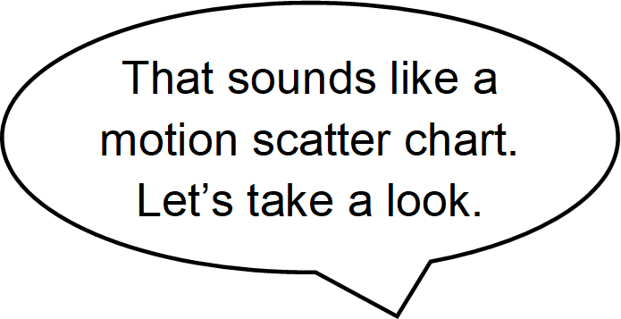
Motion Scatter Chart
Formulate Story
First consider which data you want on your axes—which data might be influenced by which other data, e.g. the correlation between average salaries for non-supervising librarians and the total number of borrowers.
These fields need to be Measures, which are essentially numerical data that can be used in mathematic computations.
Frame Chart
Drag the average salaries field to Columns in the top, right pane. The columns are what will show on the horizontal, or bottom axis.
Drag the total borrowers to Rows in the same pane. This will show on the vertical, or side axis.
From the Show Me pane, click the scatter plot.

Slide 10
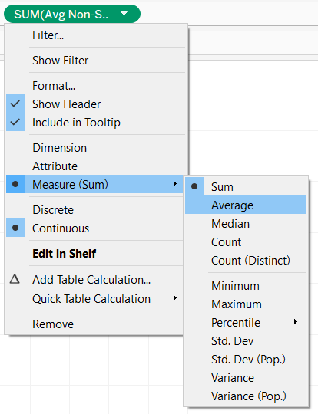
Motion Scatter Chart (cont’d)
Browse under Data & Tools.
Set Aggregation
Click the arrow to the right of each field and select Measure>>Average.
Setup Data Points
Change the mark type to Pie via the Marks dropdown.
Determine a field for your data points, e.g. Libraries. This needs to be an entity, which in Tableau is a Dimension, or basically data on which mathematic operations cannot be performed.
Drag Libraries to the Detail box in the Marks pane.
Decide which measure to use for size, e.g. the total collection size. It should be something which may correlate with the other fields already used and which is closely tied to the data we will use for the pie chart sections.
Drag Total Collection onto the Size box in the Marks pane. If necessary, change the aggregation type to average.

Slide 11
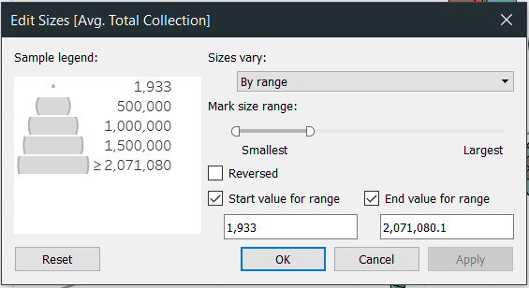
Motion Scatter Chart (cont’d)
Browse under Data & Tools.
Size Data Points
Change the size of the data points to make them more legible by clicking on the Size box and moving the slider to the right.
For greater control over the size of the circles, click to the right of the size legend and select Edit Sizes…. Changing the sizes to vary by range grants flexibility in setting the smallest size to ensure data points are visible.
If the data range is too great for the smallest and largest data points to be meaningful, check the boxes of the start and end values for the range to assign values before and beyond which the size will not change.
Configure Pie Charts
Add a border to the pie marks to make them easier to distinguish by clicking on the Color box and choosing a color under Effects>>Border.
Drag the Collection Type field to the Color box.
Drag the Collection Size field to the Angle box to add detail to the pie mark.

Slide 12
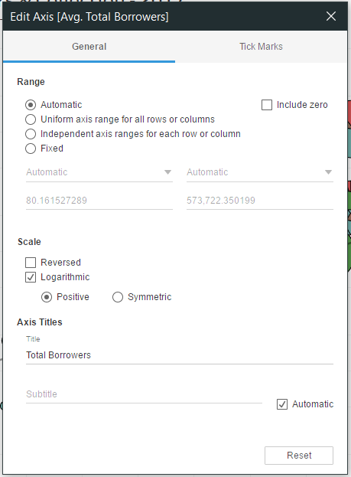
Motion Scatter Chart (cont’d)
Browse under Data & Tools.
Customize Color
If the colors aren’t suitable, click on the Color box or on the arrow to the right of the Collection Type legend and select Edit Colors….
Select a different palette from the drop down, and click on Assign Palette.
Choose a different color from the displayed palette for the selected data item by clicking the color swatch.
Edit Axis
We’ve got a scatter chart with pie marks now, but the data points are essentially horizontal and vertical because of the wide range of values in the total borrowers.
Change the Scale to Logarithmic from the Edit Axis… option of the y-axis contextual menu.
Rename the axis for conciseness.
Eliminate unused space and increase data density by unchecking the option for Include zero.

Slide 13
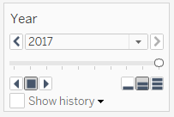
Motion Scatter Chart (cont’d)
Browse under Data & Tools.
Filter Data
Filter 0 values in Tableau rather than deleting them from Excel in case you need these records for other visualizations. Note: If some entities have 0 values for some periods but provide data for others, create an untouched copy of the Excel file for future use and delete from this file all records for an entity with any missing data to ensure trends can be spotted.
Click on the arrow next to each measure in both the Marks pane and the Columns and Rows pane and choose Filter….
Click on the At least tab and change the starting value to 1.
Animate Chart
Drag the Year field to the Pages pane in the top-middle of the window to add animation.
A year navigation box has now appeared to the right, and clicking on an arrow to the right or left of the stop button will play the animation.

Slide 14
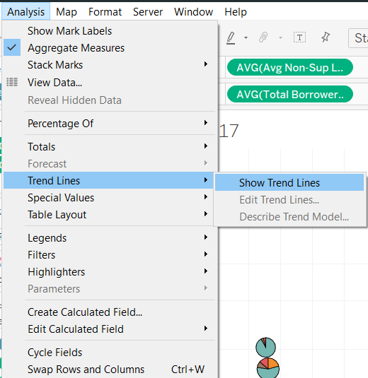
Motion Scatter Chart (cont’d)
Browse under Data & Tools.
Set Trend Line
Click on Analysis>>Trend Lines>>Show Trend Lines.
Click on Analysis>>Trend Lines again, and this time choose Edit Trend Lines….
Check the radio button next to the Exponential model type (necessary because of the logarithmic scale).
Under Options>>Include the following fields as factors, uncheck the box for Collection Type.
Edit Titles
Right click on the sheet tab and choose Rename. The sheet name you choose will be the default chart title, but we will change the chart title, so keep the worksheet title concise so you can fit in multiple sheets while still being able to recognize the tab.
Right click on the chart title and choose Edit Title…. The title should again be concise but clarify to viewers what they are seeing.

Slide 15
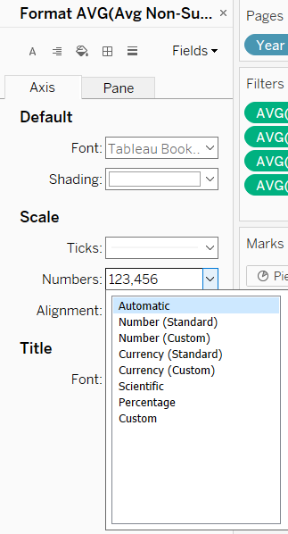
Motion Scatter Chart (cont’d)
Browse under Data & Tools.
Format Currency
Click on the arrow to the right of the salary field in Columns and choose Format….
In the left pane under Scale, click the dropdown arrow to the right of Numbers, and choose Currency (Custom).
Change the decimal places to 0 and click out of the dialog box.
Go to the Pane tab and do the same thing for Numbers under Default, which will update Totals and Grand Totals.
Edit Tooltip
Click the Tooltip box, remove “Avg.” from the tooltip field titles as appropriate, and rearrange the text to position it according to importance.
You now have a motion scatter chart with pie charts!

Slide 16
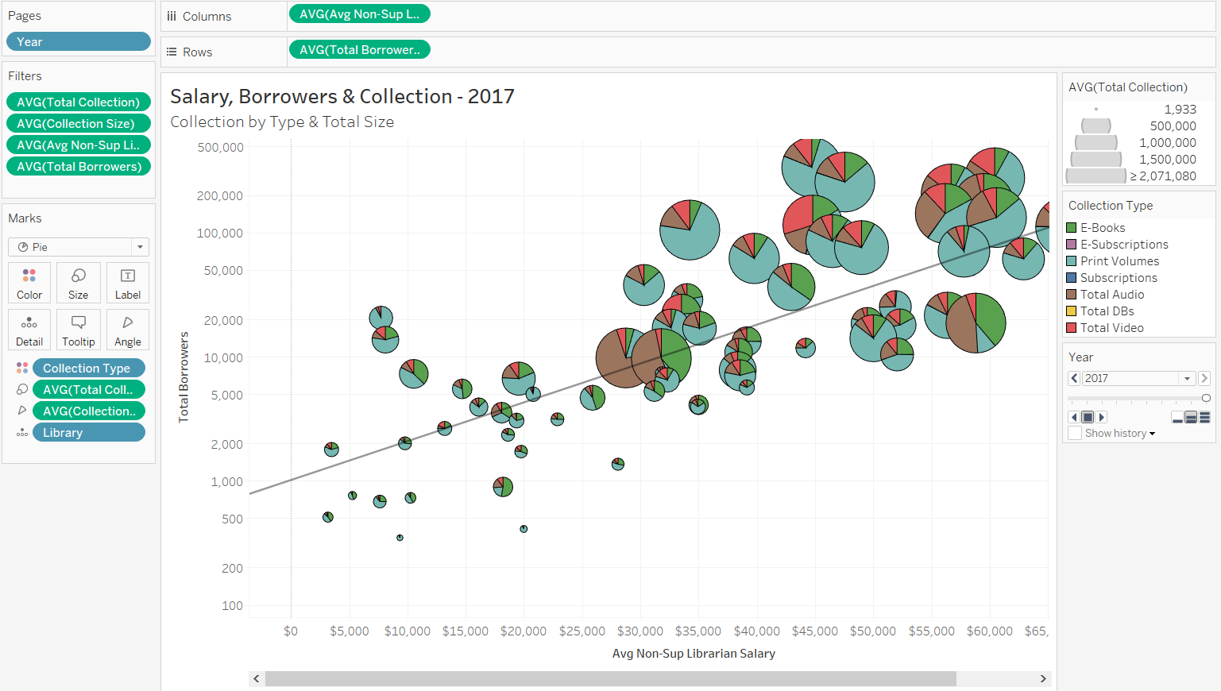
Motion Scatter Chart (cont’d)
Finished View

Slide 17
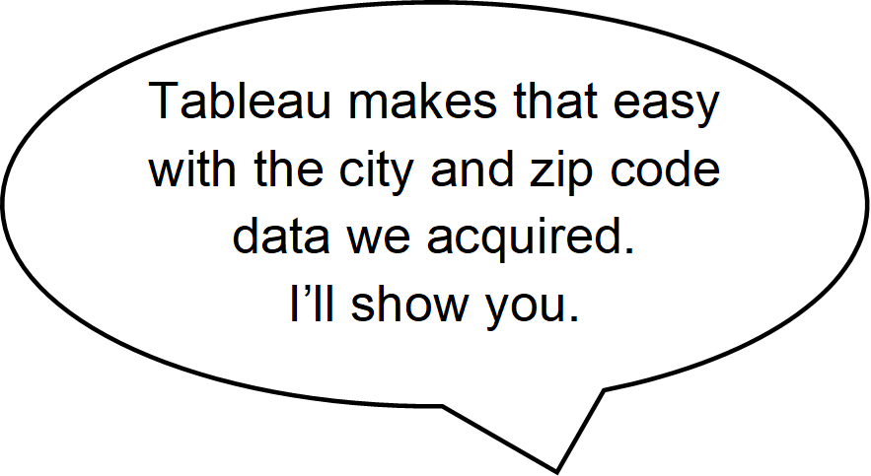
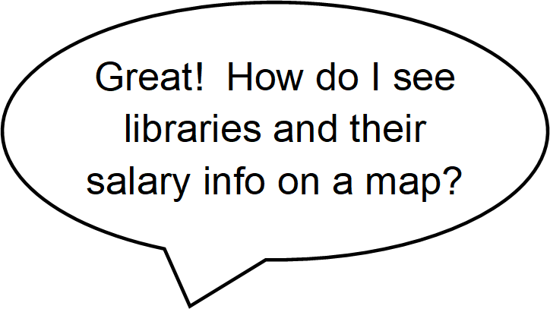
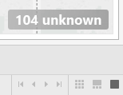
Symbol Map
Setup Worksheet
Click on the tiny chart with a plus sign icon to the right of your current worksheet at the bottom of the window to create a new worksheet.
Drag location information to the Columns. Use the zip code for the greatest precision.
In the Show Me chart pane, click the symbol map icon to confirm the type of chart so Tableau will translate your data to coordinates.
Edit Locations
Click on the 104 unknown message at the far bottom right of the window.
Click on the Edit Locations… option from the dialogue box that opens.
Under Geographic roles>>Country/Region, click on the drop down and select the Fixed radio button and United States from its drop down menu.

Slide 18
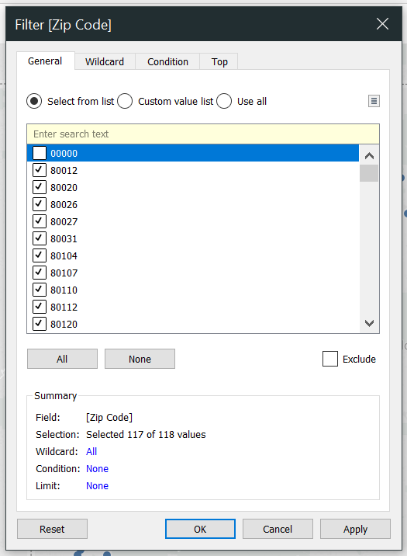
Symbol Map (cont’d)
Browse under Data & Tools.
Review Data
Click on the Data Source tab at the bottom of the window to investigate unresolved locations.
Mouse over the Zip Code header, and click on the button that appears to reverse the sort order so the 00000 area code comes first.
Scrolling across the record reveals that no data was entered for this library at all, so it can be safely filtered out.
Filter Locations
Click to the right of the Zip Code Detail mark, and choose Filter….
Uncheck the box next to 00000, and hit OK.

Slide 19
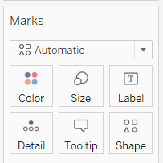
Symbol Map (cont’d)
Browse under Data & Tools.
Add City Labels
Drag the City field to the Label box to add in the city names.
Not all cities are labelled, but this will vary with the zoom level.
Click the 71 unknown message in the bottom right of the window to resolve location ambiguities.
Click Edit Locations…, and select Colorado from the State/Province>>Fixed dropdown.
Research Data Anomalies
Security-Widefield is still unrecognized, and a quick web search for it reveals that it is located in Colorado Springs.
Click on Unrecognized under Matching Location, and select Colorado Springs from the dropdown menu.
If you encounter a city for which you cannot determine a recognized location for the unknown data, simply filter it out as you did for zip codes.

Slide 20
Symbol Map (cont’d)
Browse under Data
Configure Measures
Drag the average non-supervising librarian salary field out of the Staff folder to the Size box.
Change the aggregation method under the mark’s Measure option to Average.
Change the size of the circles via the slider accessed through the Size box.
Configure Color
Choose a dimension which might be correlated with salary to differentiate the data points by color, e.g. the type of library.
Drag Legal Basis to the Color box.
To better differentiate the data points with a border, click the Color box, and select a color from the Effects>>Border dropdown.

Slide 21
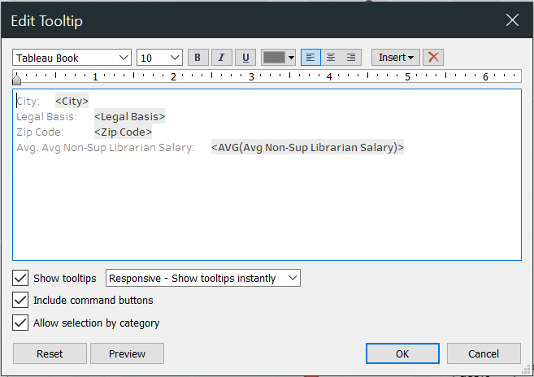
Symbol Map (cont’d)
Browse under Data & Tools.
Filter Salaries
Click to the right of the salary Mark field, choose Filter…., and under the At least button set the value to 1.
Tidy Display Details
Remove “Avg.” from the tooltip field title, and rearrange the text to position it according to importance.
Edit Legend Title
Click to the right of the legend title, and choose Edit Title… to move the important information to the front so it fits in the legend window and to push the non-essential information to the end where it is still available.

Slide 22
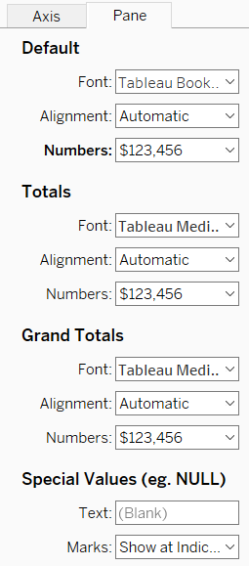
Symbol Map (cont’d)
Browse under Data & Tools.
Format Currency
In the tooltip, the salaries show no currency symbol, so click to the right of the salary Mark field, and select Format….
Click the Pane tab, and choose Currency (custom) from the Numbers dropdown under Default.
To conserve space, change the number of decimal places to 0.
Edit Titles
Double click the sheet name to rename it using a concise title that will still clearly inform you which worksheet is which.
Right click the chart title, choose Edit Title…, and in the text box type a concise title which also explains to the users what the chart is showing them. Maintain consistency across charts with bolding and font size.
Your map is ready to go!

Slide 23
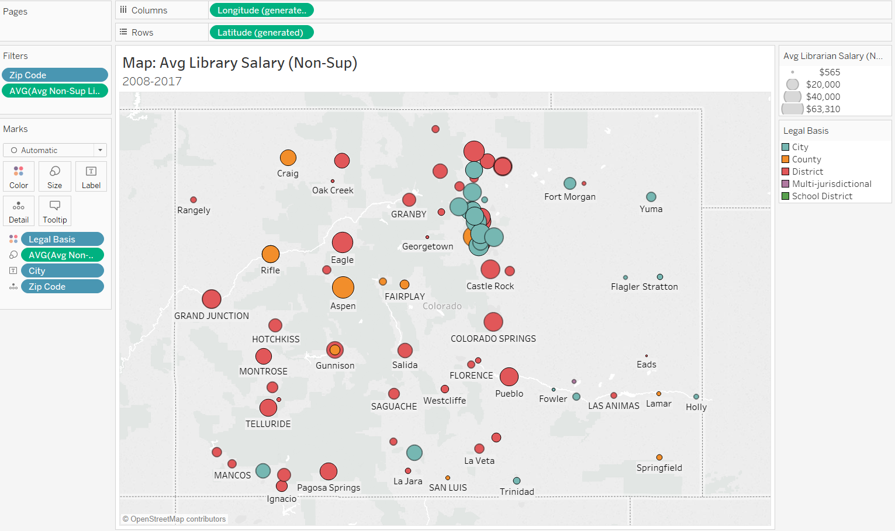
Symbol Map (cont’d)
Finished View

Slide 24
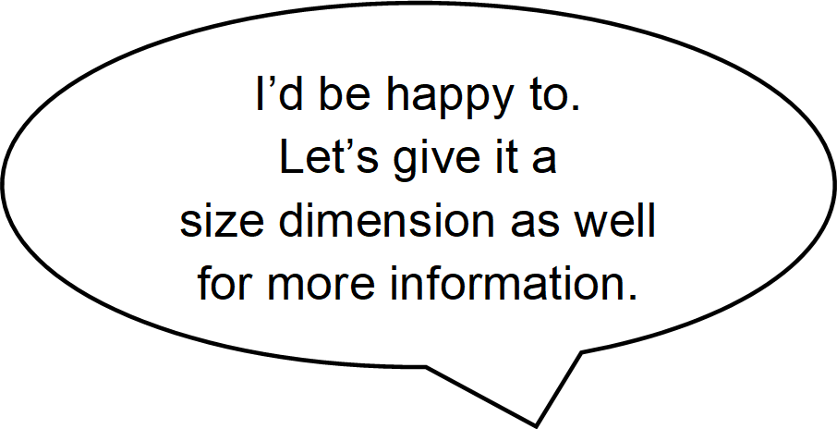
Line Chart
Setup Worksheet & Axes
Create a new worksheet on which to create the chart.
Our line chart will show change in salaries by required education level across time, so our axes will be for salary and year.
Drag Year to the Columns.
Drag the salary field to the Rows.
In the Show Me chart pane, click the first line chart.
Change the aggregation type of the salary field to Average.
Configure Color
Drag the MLS field to the Color Mark box.
Filter out invalid MLS values.

Slide 25
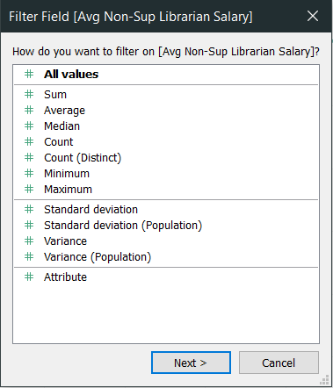
Line Chart (cont’d)
Browse under Data & Tools.
Tidy Salary Display
Format the field for the Axis and Pane.
Edit the axis title.
Filter Salary
Remove empty and 0 value salaries so they are not averaged into the output.
Drag the salary field from the Data pane into the Filter.
Choose All values from the ensuing dialog box.
Hit Next, and filter for values which are at least 1.

Slide 26
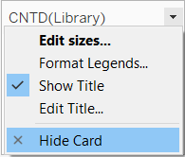
Line Chart (cont’d)
Browse under Data & Tools.
Size Lines
Drag Library to the Size Mark box.
Consolidate the lines into just one for each MLS status by right clicking on the Library mark you just added and choosing Measure>>Count (Distinct).
Adjust the line size.
Tidy Legends & Tooltip
Rename the MLS legend title for conciseness.
Click to the right of the CNTD(Library) legend, and select Hide Card.
Edit tooltip labels.

Slide 27
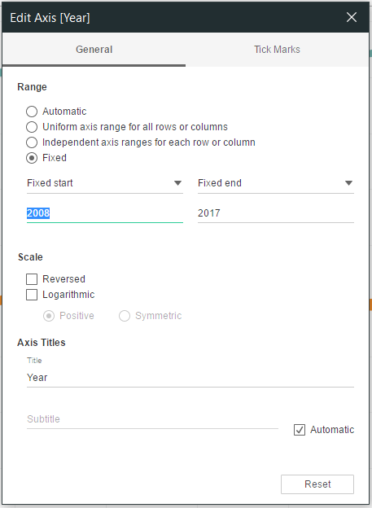
Line Chart (cont’d)
Browse under Data & Tools.
Edit Axis
Edit the year axis to eliminate wasted space.
From the Edit Axis [Year] dialog box, click on the Fixed radio button.
Change the Fixed start and Fixed end text fields to the actual start and end values of the data.
Edit Titles
Rename the worksheet.
Edit the chart title.
Save.
You now have a line chart!

Slide 28
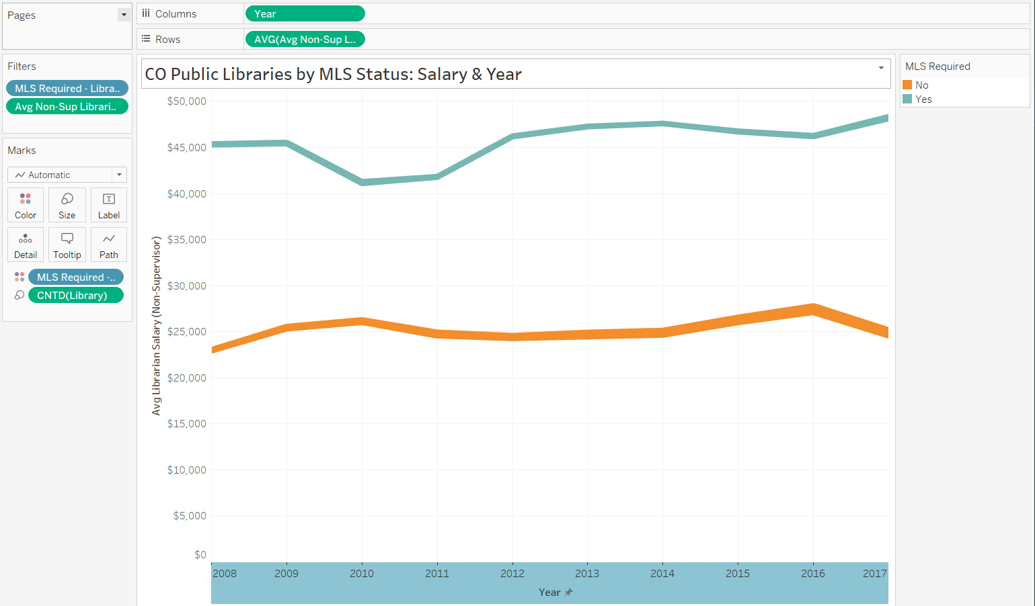
Line Chart (cont’d)
Finished View

Slide 29
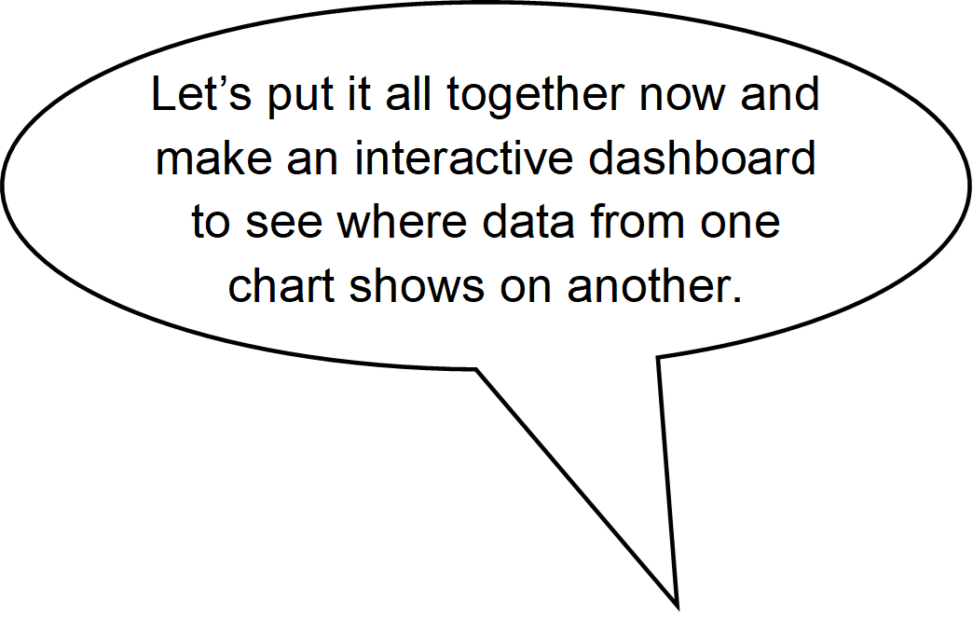
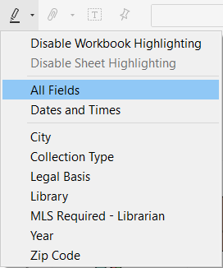
Dashboard
That sounds awesome!
Create a Basic Dashboard
Click on the New Dashboard grid icon from the bottom tabs.
Drag the worksheets you already created to the right pane.
Enable Highlighting
From the toolbar at the top, click on the highlighter icon to ensure that when a data point is clicked on one chart, it is highlighted on the other charts.
Select All Fields.

Slide 30
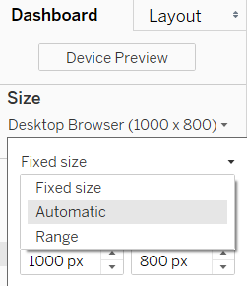
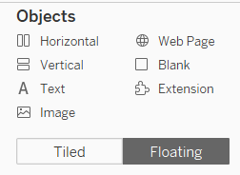
Dashboard (cont’d)
Browse under Data & Tools.
Rethink the Basic Dashboard
Corrections to this quick and easy dashboard are needed to make it visually sound. This applies not just to the layout, but also to the consistency of visual cues between the worksheets on the dashboard.
Adjust Basic Layout
In the Dashboard pane, from the dropdown below Size click the dropdown arrow to the right of Fixed size.
Select Automatic to allow Tableau to resize to match the screen size.
Click on the Floating button at the bottom of the Dashboard pane under Objects. This will let us to independently resize objects and move them out of the fixed grid.

Slide 31
Dashboard (cont’d)
Browse under Data & Tools.
Consider Clarity
Before we start refining the formatting, consider whether all the worksheets should be included on the dashboard. To be included, a chart should be clear to understand within the context of the dashboard.
In our dashboard, clicking on a point in the line chart only highlights the data point in the scatter chart if it happens to be showing the same year; it does not advance the scatter chart to that year. At a glance, it seems like the scatter chart has no corresponding data points, which could confuse the viewer. The map chart also does not sync, but this can be corrected by adding Year to the Pages shelf. The line chart, however, specifically shows change over time and cannot be so easily correct. As it stands, this disconnect undermines the ease and efficiency of reading the visualization, so remove the line chart from the dashboard.
Remove Unclear Chart
Click the line chart.
Click the X at the top corner (it may be on the right or left side).

Slide 32
Dashboard (cont’d)
Browse under Data & Tools.
Assess Visual Cues
Now consider the scatter chart. The size of the circles draws the attention, shifting it to the collection size they represent and away from salary. The pie charts themselves, with all the information they display, overload the dashboard. Also, the same colors are used in the pie chart as in the map, but they mean different things, which can further confuse the viewer.
To be the most efficient and easiest to understand, size and color—two primary visual cues—should be consistent between charts so viewers don’t have to remember different associations for the same visual cue. Anything more involved should be developed through a story, building from easy to hard to train the viewers.
Duplicate Original Chart
Right click the scatter chart tab at the bottom of the window, and select Duplicate so you still have the collection visualization for future use.
Rename the new worksheet to clarify that it is the one with pie charts.
Return to the original worksheet tab. Note: We’re modifying not the duplicate but the original worksheet to maintain its connection in the dashboard.

Slide 33
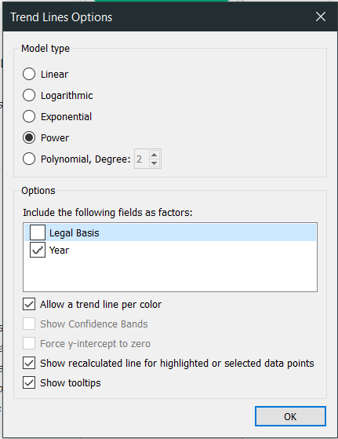
Dashboard (cont’d)
Browse under Data & Tools.
Edit Chart
Change the Marks to Circle.
Remove the Collection Type Color Marks field and the collection size (type-specific as opposed to total collection) Detail Marks field.
Drag Legal Basis to the Color Marks box.
Swap the collection size and salary fields by dragging them from their shelves to each other’s shelves.
Edit Chart Scale & Trend Line
Change the x-axis to a logarithmic scale.
From the Edit Axis… dialog box, uncheck Include zero to eliminate wasted white space
From Trend Line Options, remove the extra trend lines so only that for year shows.
Set the Model type to Power.

Slide 34
Dashboard (cont’d)
Tidy Chart Display
Edit the axis title.
Edit the chart title.
Edit the legend title.
Edit the tooltip to remove unnecessary aggregate terms and to rearrange fields in order of importance.
Page Chart Years
Click on the map worksheet tab.
Drag Year to the Pages shelf.

Slide 35
Dashboard (cont’d)
Browse under Data & Tools.
Coordinate Size
Switch to the map worksheet, and go to Edit sizes… from the size legend.
Grab a piece of paper and a soft-tip marker, and hold the paper up to your screen so that the edge aligns with the left border of the dialog box.
Make a mark at the edge of the paper where the inner border of the right slider is, and Cancel out.
Add Library to the Detail Mark box so both charts have the same details and will highlight each other when a data point is clicked.
Switch to the scatter chart, and go to Edit sizes… from the size legend.
Hold the paper up to your screen so that the edge aligns with the left border of the dialog box.
Adjust the slider so the inner border is directly above the mark on the paper.

Slide 36
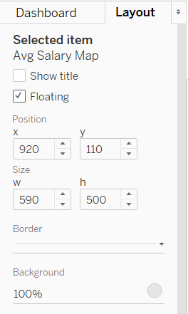
Dashboard (cont’d)
Browse under Data & Tools.
Fine Tune Layout
Right click the chart titles, and select Hide Title.
From the Layout tab to the left check the box next to Floating, resize the map to eliminate the wasted space on either side by setting x and y , and then reposition it by setting w and h.
Click the arrow to the right of Border, select the solid line, and change its color to a light gray which won’t draw the eye but will still lend a subtle border.
Repeat the steps for the scatter chart and legends.
Adjust Legend Columns
Hover the cursor to the left of the third column until a double-sided arrow and a dashed line appear.
Drag the arrow until the full text of each library basis shows. The size you select applies to every column.

Slide 37
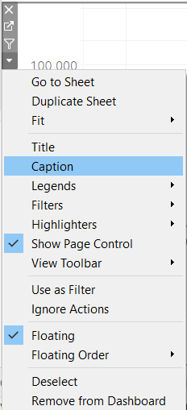
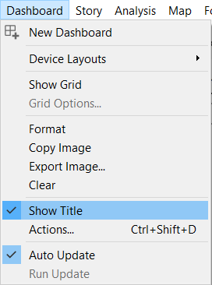
Dashboard (cont’d)
Browse under Data & Tools.
Create Dashboard Title
Click on Dashboard in the menu bar, and select Show Title.
Right click on the title, and choose Edit Title.
Create Captions
Click on a chart, and then on the arrow in the top corner. The arrow may be on either the right or left side.
Select Caption.
Right click on the caption, and then select Edit caption….

Slide 38
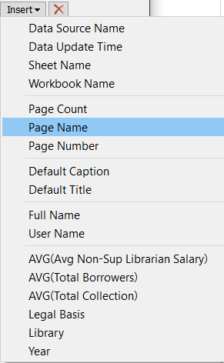
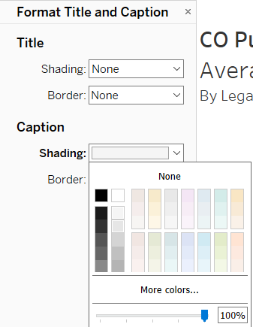
Dashboard (cont’d)
Browse under Data & Tools.
Add Year to Caption
Click on the Insert dropdown, and choose Page Name.
Format Map Caption
Right click on the caption, and select Format caption....
From the Format Title and Caption pane which appears to the left, under Caption, choose a light gray from the Shading dropdown.
Format Map Background
While the map is still selected, click on Background from the Layout pane on the left, and select the same light gray.
Rename the dashboard sheet.
You now have a dashboard! Give it a whirl!

Slide 39
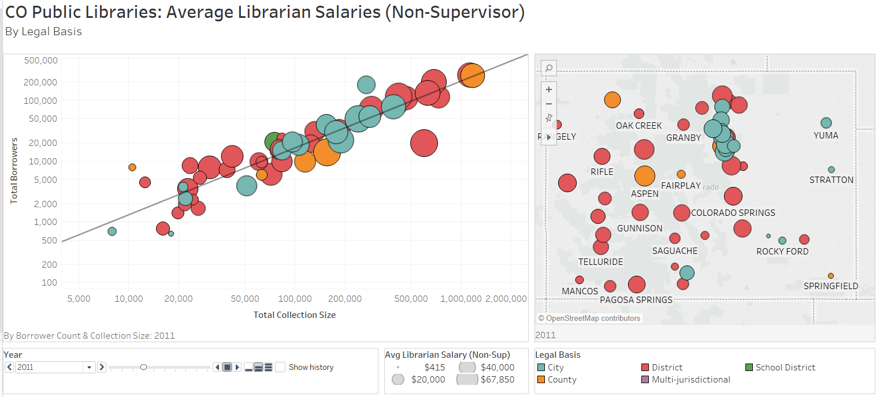
Dashboard (cont’d)
Finished View

Slide 40
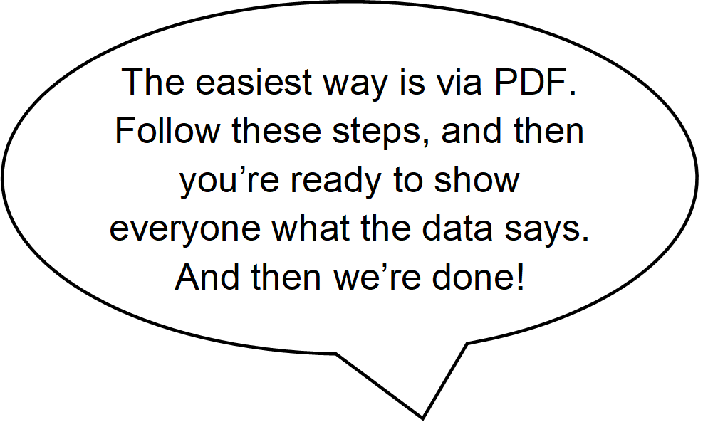
PDF
Now that I have all these amazing, informative charts, how can I share them?
Evaluate Options
Tableau offers several options to share visualizations, but each is at the expense of budget or privacy.
Tableau Server is really for larger organizations with the budget and staff to manage a server and warrant collaboration.
Tableau Online is available at a cost.
Embedded Analytics is available at a cost.
Tableau Public is free, but the visualizations are public, which would not be suitable for anything an organization may wish to keep private.
The simplest way to share your visualizations is to print them to PDF so you can distribute them via email, intranet, website, etc. Note: This method only produces a static copy.

Slide 41
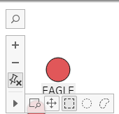
PDF (cont’d)
Browse under Data & Tools.
Select Data to Share
From the Year legend click on the dropdown arrow, and select 2017.
Click on City in the Legal Basis legend.
Pan and zoom the map.
Click the arrow in the mouse-over control panel, select the perpendicular arrows, and pan to the area of interest.
Print to PDF
Click in the Dashboard pane to the left to unselect all objects.
Click on File, select Print to PDF…, and hit OK.
Select the location where you wish to save the PDF, name it, and hit OK.
You now have a PDF and can email this to your supervisors along with your insights.

Slide 42
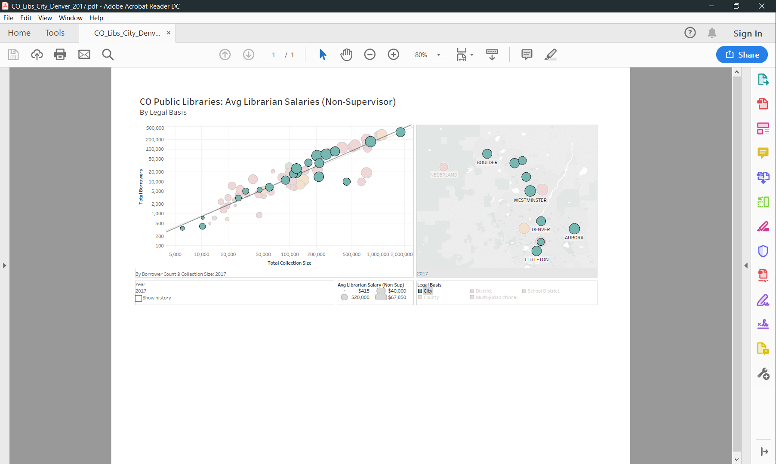
PDF (cont’d)
Finished View

