Slide 1
Visualizing Data for Libraries
Mahogany Elven Lore, Rutgers University
December 2018

Slide 2
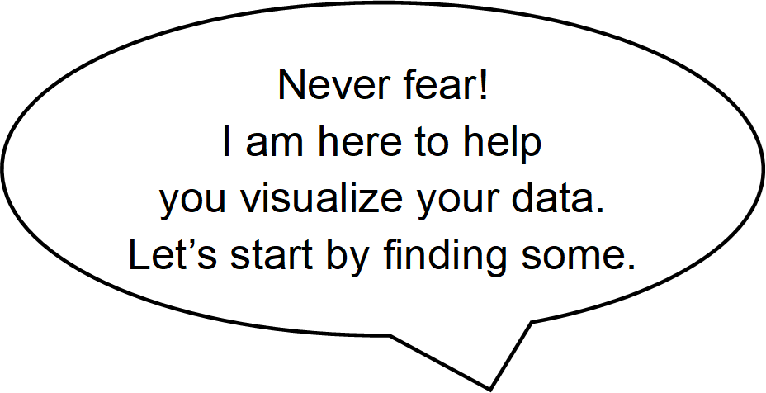
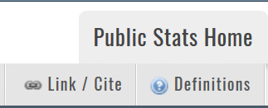
Acquire Data
Library Research Service is a phenomenal resource for library data: https://www.lrs.org/.
Browse under Data & Tools.
Choose Public Libraries>>Colorado Public Library Statistics and Profiles.
Under Public Library Annual Report Data (1987 – present), hit Go to Survey Data button.
Inspect the Definitions in the data menu bar to determine which fields you want to use.
Hint: Copy and paste definitions into a Word document and highlight each field of interest using a color gradient according to how likely you are to use it now versus in the future.

Slide 3
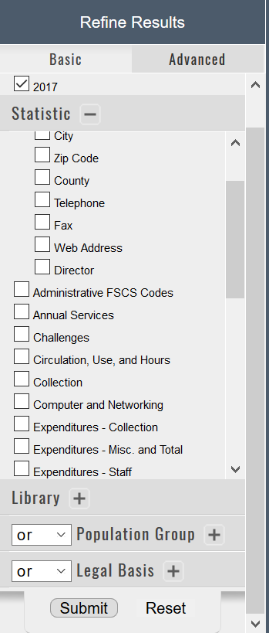
Acquire Data (cont’d)
Browse under Data & Tools.
Hit the Advanced tab in the Refine Results pane.
Click the + sign next to each data field group header to expand the fields.
For this tutorial, only select one year at a time.
Check the boxes next to the data fields you selected from the definitions.
Hint: Avoid having to come back to acquire all the data a second time. Collect fields you might want to use in the future as well.
Alternatively, hit the data menu bar Master File option to export all the data for the current year in CSV format.
Scroll to the bottom and hit Submit.

Slide 4
Acquire Data (cont’d)
Browse under Data & Tools.
Hit the data menu bar option with the Export results below in .csv format tooltip.
Name and save the CSV file in your data directory.
Select the next year from the Advanced tab in the Refine Results pane and repeat until you have exported all the years of data you want.

Slide 5
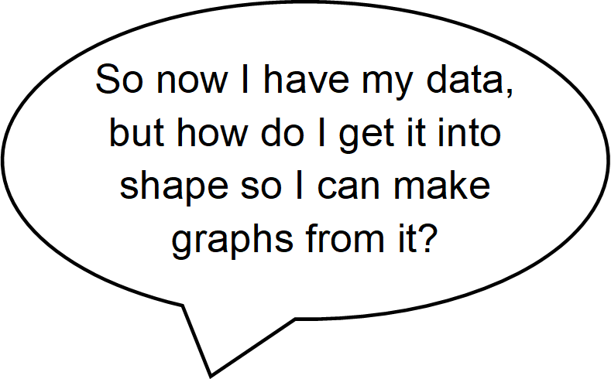
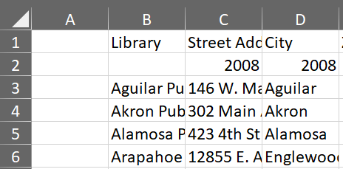
Prepare Data Excel
Open Excel and create and save a new spreadsheet.*
Open the first CSV file. Change the file type to All Files to see it.
Copy the data minus the file headers and footers.
Paste the data into the second column of your spreadsheet.
Delete the year row.
*These instructions are for Office 365.

Slide 6
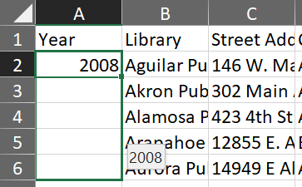
Prepare Data Excel (cont’d)
Browse under Data & Tools.
Type Year in the first column header.
Type the dataset’s year in the first column, first row for that year.
Click in the bottom right corner of the cell and drag the + sign to the last row of that year’s data.
Save.
Repeat for each of the remaining CSV files, but do not copy the data headers.

Slide 7
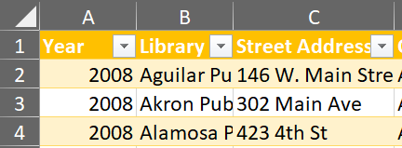
Prepare Data Excel (cont’d)
Browse under Data & Tools.
Hit CTRL + A to select all your data. Be sure the header row is selected, too.
In the ribbon bar under home, hit Format as Table and apply a table style to make it easier to sort and filter.
Rearrange columns to bring fields you will be visualizing now to the beginning of the spreadsheet.
Right click on the letter above the column header you want to move.
Select Cut.
Right click on the letter above the column header you want the cut column to be in front of.
Select Insert Cut Cells.

Slide 8
Prepare Data Excel (cont’d)
Browse under Data & Tools.
Rename the data worksheet and create a new one for a key.
Create a color coded key to identify types of edits, and apply those colors as you edit.
You may need to update the key as you work with the data and uncover more types of edits you need to perform.
Sort columns by clicking the arrow to the right of the column header to easily identify missing data.
Copy values from appropriate cells and paste to cells with empty or 0 values (for example, from available low salaries to missing high salaries and vice versa).
Insert a column next to fields you want to aggregate.
Right click on the letter above the column header you want the cut column to be in front of.
Select Insert. Rename the column header.

Slide 9
Prepare Data Excel (cont’d)
Browse under Data & Tools.
Add values by typing =SUM( to add cells or =AVERAGE( to average them and then selecting and dragging the cells you wish to add. Close the parentheses with ) and then hit enter.
If Excel does not automatically apply the same formula to all rows in the column, mouse over the bottom right corner and drag the + sign to the end of the column.
Save and close your spreadsheet.

Slide 10
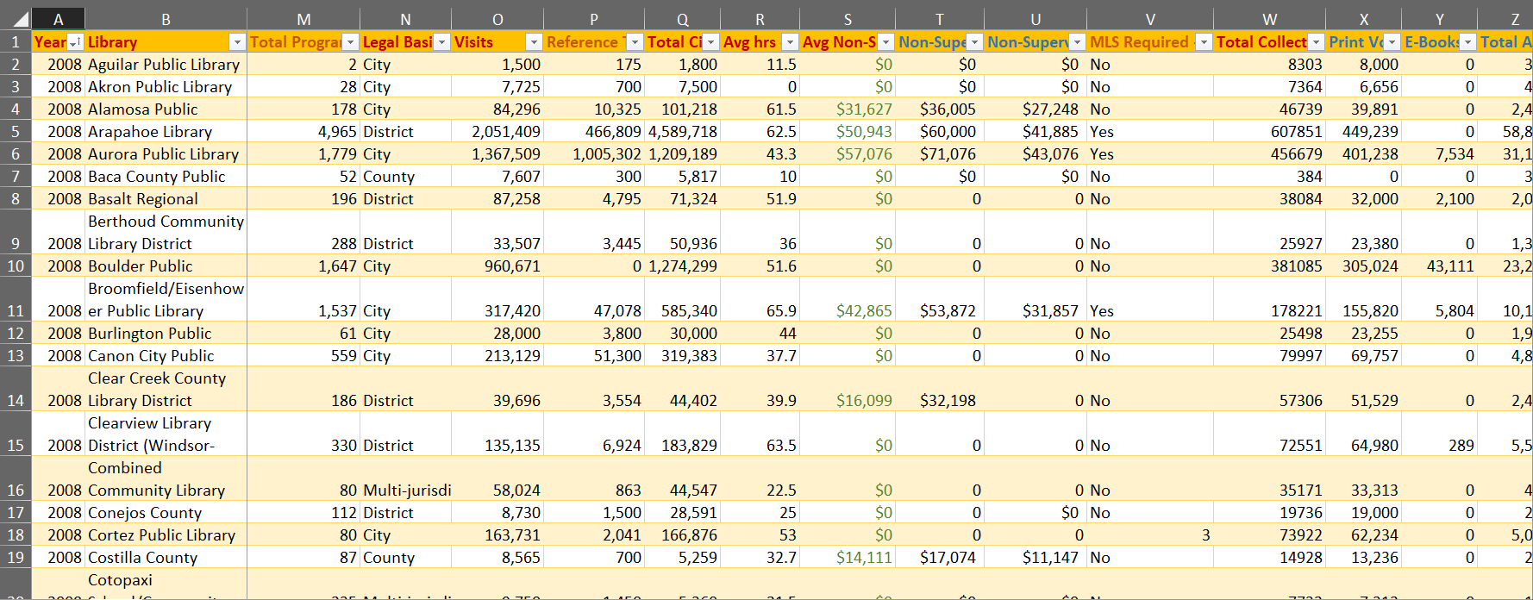
Prepare Data Excel (cont’d)
A view of the final version of the Excel file

Slide 11
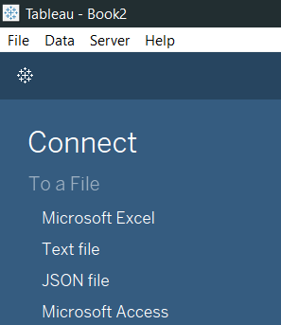
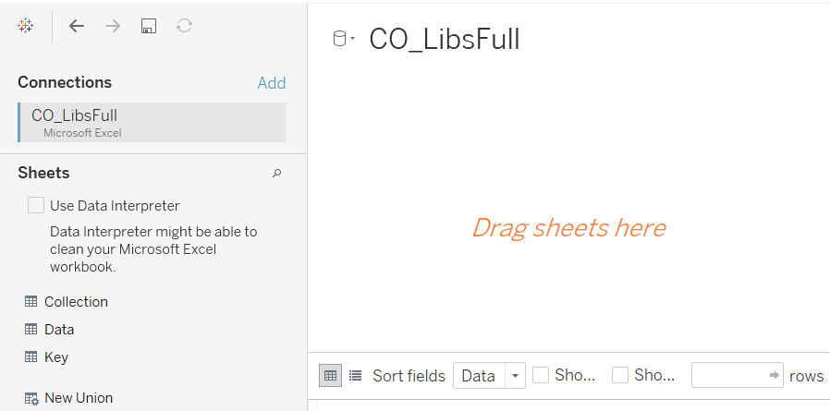
Prepare Data Tableau
Browse under Data & Tools.
Launch Tableau.*
From the left pane select the option to connect to a Microsoft Excel file.
Browse to and select the Excel file you created. Hit the Open button.
Drag the worksheet containing the data to the right-side window.
Save your file.
*These instructions are for Tableau 2018.2.0.

Slide 12
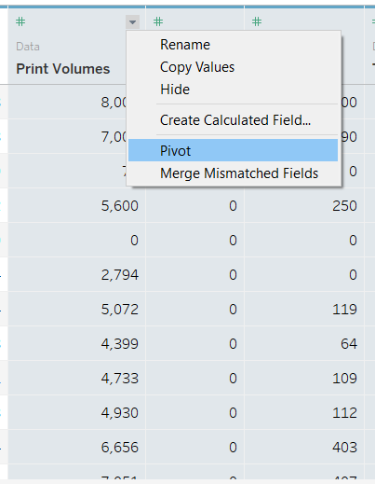
Prepare Data Tableau (cont’d)
Browse under Data & Tools.
In order to create visualizations like pie charts which show, for example, how many of each type of collection were in the whole of the collection, the columns must be pivoted from those which give a count for each type in its own column to a set of two columns, one for the count and one for the collection type.
Scroll to the columns in question and select them all by control clicking each one.
Click on the arrow to the top right of the column header and choose Pivot.
The pivoted columns are now at the end. Check to be sure the pivot achieved the desired results. Note: By default only the first 1,000 rows show, so you will need to show more if you are concerned that not all your data made it through the pivot.
Click on the arrow to the right of the header and choose Rename to apply a meaningful name.

Slide 13
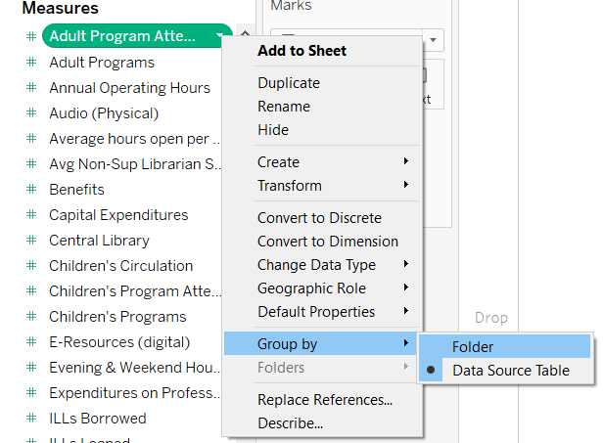
Prepare Data Tableau (cont’d)
Browse under Data & Tools.
Now that the data itself is prepped, organize the data view to make your work more efficient by grouping fields before starting your visualization.
Click on Sheet 1 from the bottom tabs.
Select any field and right click or click on the arrow to the right to select Group by>>Folder.
Hint: Right clicking can avoid the pesky habit of Tableau thinking you want to rename the field.

Slide 14
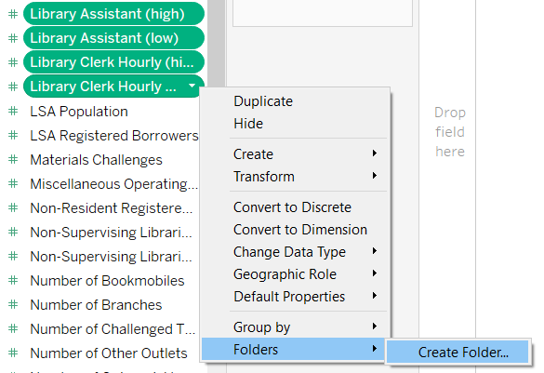
Prepare Data Tableau (cont’d)
Browse under Data & Tools.
Select the first field to group and SHIFT+Click the last field for adjacent fields or CTRL+Click each non-adjacent field.
Right click and choose Folders>>Create Folder. Optionally you can add fields you previously missed to an existing folder here, too.
Name the folder and hit enter or OK.
Save again, and you are ready to start visualizing.

Slide 15
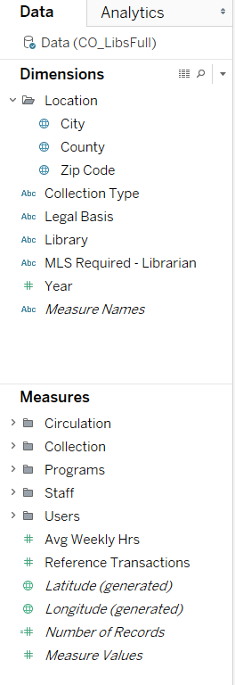
Prepare Data Tableau (cont’d)
A view of the final organization of the Tableau data

Slide 16
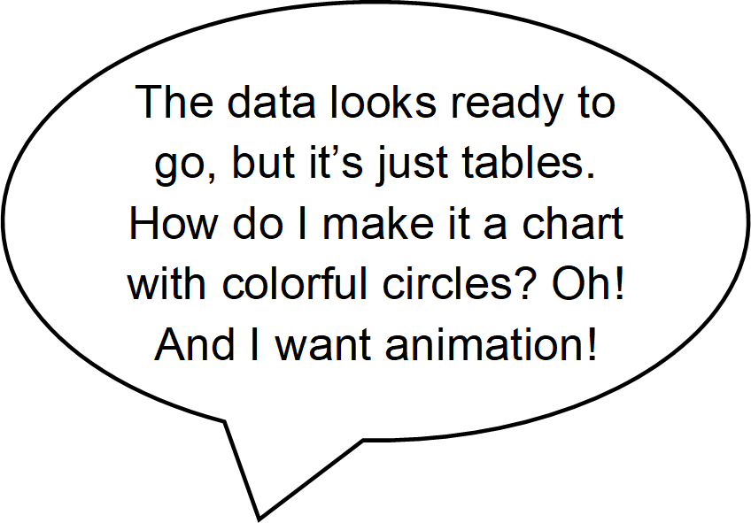
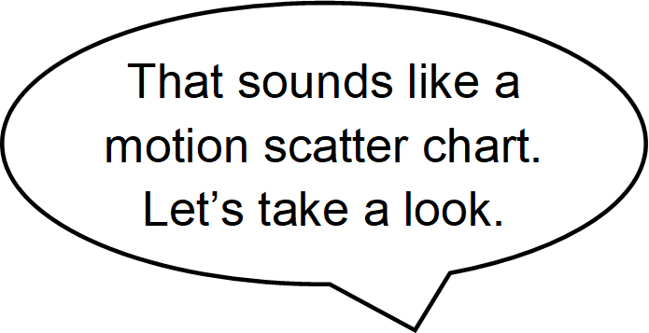
Motion Scatter Chart
First consider which data you want on your axes—which data might be influenced by which other data.
These fields need to be Measures, which are essentially numerical data that can be used in mathematic computations.
For this tutorial, we will examine the correlation between average salaries for non-supervising librarians and the total number of borrowers.

Slide 17
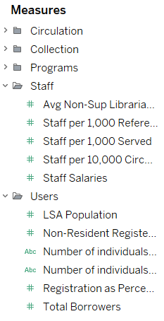
Motion Scatter Chart (cont’d)
Browse under Data & Tools.
Expand a folder to access the fields grouped within.
Drag the average salaries field to Columns in the top, right pane. The columns are what will show on the horizontal, or bottom axis.
Drag the total borrowers to Rows in the same pane. This will show on the vertical, or side axis.
From the Show Me pane, click the scatter plot.
Toggle off the Show Me pane to give you more viewing space.

Slide 18
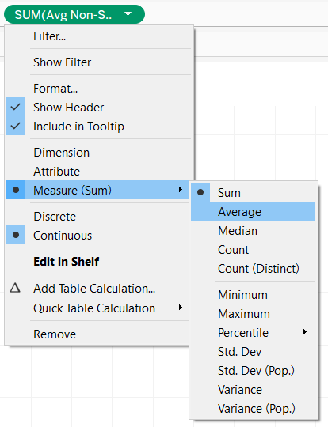
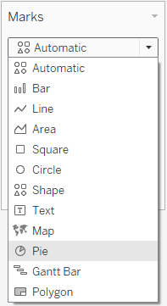
Motion Scatter Chart (cont’d)
Browse under Data & Tools.
By default Tableau is summing data, so axis values are astronomical.
Fix this by clicking the arrow to the right of each field and selecting Measure>>Average.
Alternately, if you won’t be aggregating any data, turn off aggregation methods by clicking Analysis<<Aggregate Measures from the menu bar.
With the scatter chart skeleton in place, it’s time to fill in the chart.
Change the mark type to Pie via the Marks dropdown.

Slide 19
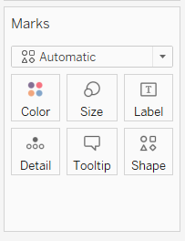
Motion Scatter Chart (cont’d)
Browse under Data & Tools.
Determine a field for your data points. This needs to be an entity, which in Tableau is a Dimension, or basically data on which mathematic operations cannot be performed.
We’ll use libraries so we can get detailed information about the measures for each library.
Drag the library field to the Detail box in the Marks pane.
Decide which measure to use for size. It should be something which may correlate with the other fields already used and which is closely tied to the data we will use for the pie chart sections.
We will use the total collection size.
Drag Total Collection onto the Size box in the Marks pane. If necessary, change the aggregation type to average.

Slide 20
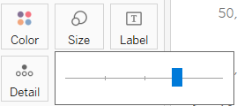
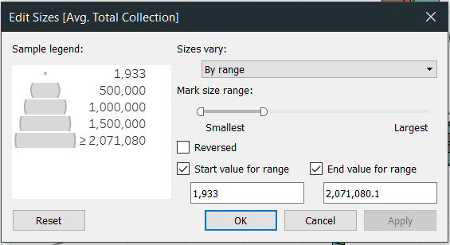
Motion Scatter Chart (cont’d)
Browse under Data & Tools.
Change the size of the data points to make them more legible by clicking on the Size box and moving the slider to the right.
For greater control over the size of the circles, click to the right of the size legend and select Edit Sizes…. Changing the sizes to vary by range can more accurately reflect size differences, especially when dealing with percentages. It also grants flexibility in setting the smallest size to ensure data points are visible.
If the data range is too great for the smallest and
largest data points to be meaningful, consider checking the boxes of the start and end values for the range to assign values before and beyond which the size will not change.

Slide 21
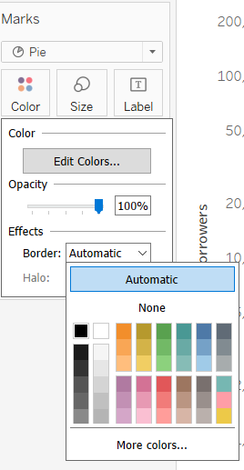
Motion Scatter Chart (cont’d)
Browse under Data & Tools.
Add a border to the pie marks to make them easier to distinguish by clicking on the Color box and choosing a color under Effects>>Border.
Now add collection type detail to the pie marks.
Drag the Collection Type field to the Color box.
If the colors aren’t suitable, change them.
Click on the Color box or on the arrow to the right of the Collection Type legend and select Edit Colors….

Slide 22
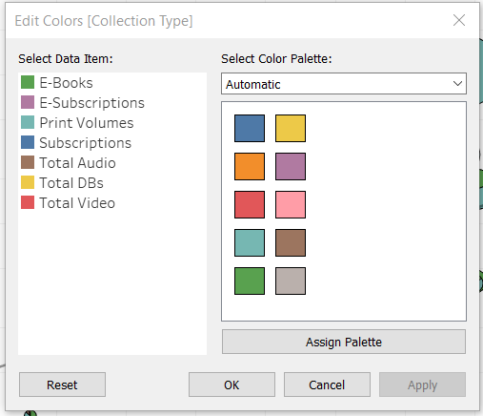
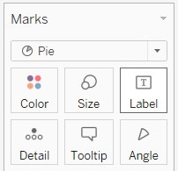
Motion Scatter Chart (cont’d)
Browse under Data & Tools.
Select a different palette from the drop down.
Click on Assign Palette.
Choose a different color from the displayed palette for the selected data item by clicking the color swatch.
Change the color for the data item whose color you just used so each item has a unique color.
Drag the Collection Size field to the Angle box to add detail to the pie mark.

Slide 23
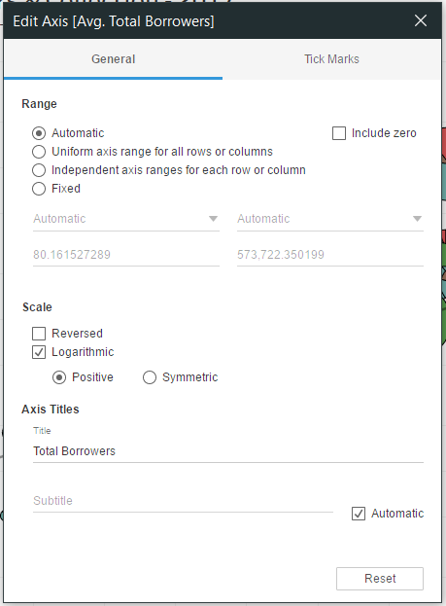
Motion Scatter Chart (cont’d)
Browse under Data & Tools.
We’ve got a scatter chart with pie marks now, but the data points are essentially horizontal and vertical. This is because of the wide range of values in the total borrowers. We need to use a logarithmic scale to correct this.
Right click on the y-axis and choose Edit Axis….
A little over half way down, check the box for Logarithmic.
Rename the axis for conciseness.
Eliminate unused space and increase data density by unchecking the option for Include zero.
X out of the dialog box.

Slide 24
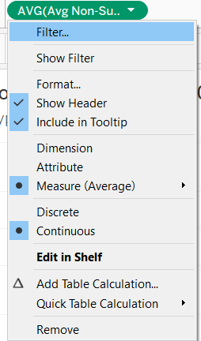
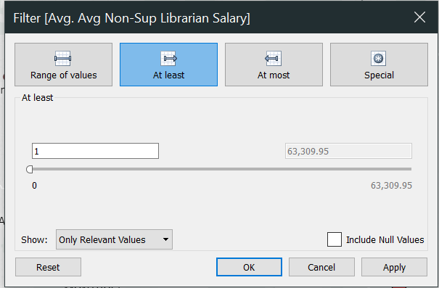
Motion Scatter Chart (cont’d)
Browse under Data & Tools.
Filter 0 values in Tableau rather than deleting them from Excel in case you need these records for other visualizations. Note: If some entities have 0 values for some periods but provide data for others, consider creating an untouched copy of the Excel file for future use and from this file deleting all records for an entity with any missing data to ensure trends can be spotted.
Click on the arrow next to each measure in both the Marks pane and the Columns
and Rows pane and choose Filter….
Click on the At least tab and change the starting value to 1.
OK out.
Readjust the pie mark size at needed.

Slide 25
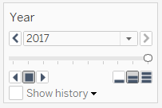
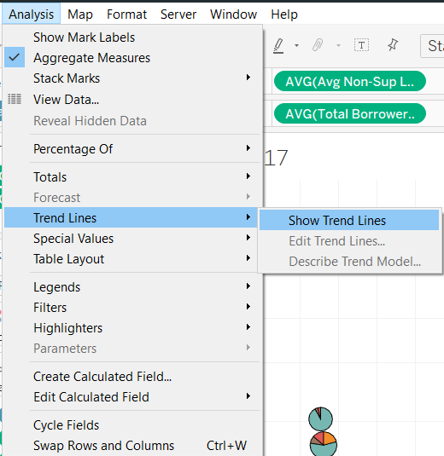
Motion Scatter Chart (cont’d)
Browse under Data & Tools.
Drag the Year field to the Pages pane in the top-middle of the window to add animation.
A year navigation box has now appeared to the right, and clicking on an arrow to the right or left of the stop button will play the animation.
Adding a trend line can help visualize the rate of change of salary to borrower size.
Click on Analysis>>Trend Lines>>Show Trend Lines.

Slide 26
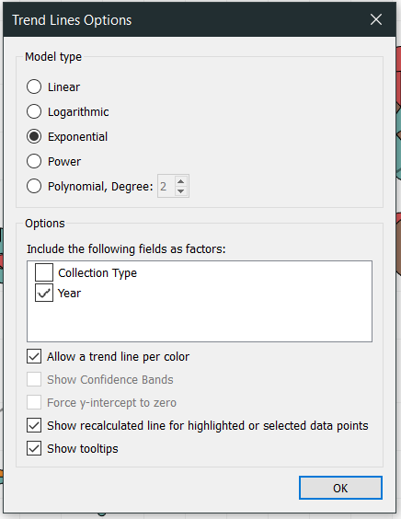
Motion Scatter Chart (cont’d)
Browse under Data & Tools.
Click on Analysis>>Trend Lines again, and this time choose Edit Trend Lines… to reduce the trend lines to one for the overall annual trend.
Check the radio button next to the Exponential model type (necessary because of the logarithmic scale).
Under Options>>Include the following fields as factors, uncheck the box for Collection Type.
Hit OK.

Slide 27
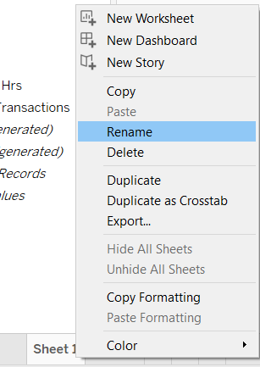
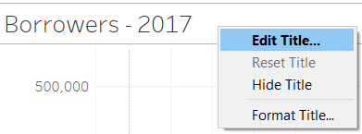
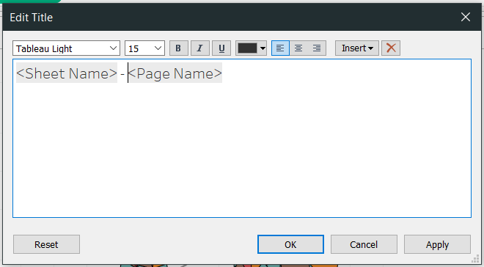
Motion Scatter Chart (cont’d)
Browse under Data & Tools.
Right click on the sheet tab and choose Rename. The sheet name you choose will be the default chart title, but we will change the chart title, so keep the worksheet title concise so you can fit in multiple sheets while still being able to recognize the tab.
Right click on the chart title and choose Edit Title…. The title should again be concise but clarify to viewers what they are seeing.
Edit the formatting with the font, font size, and font color dropdowns, and the font style and alignment buttons.
Hit OK.

Slide 28
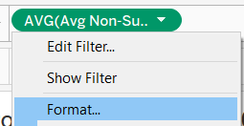
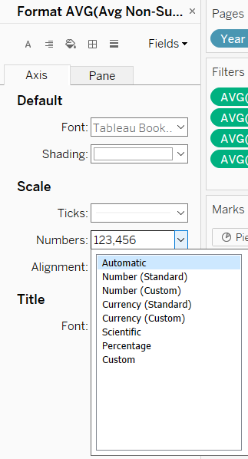
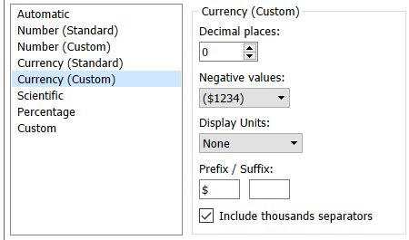
Motion Scatter Chart (cont’d)
Browse under Data & Tools.
Since salaries are monetary, change the formatting to currency.
Click on the arrow to the right of the salary field in Columns and choose Format….
In the left pane under Scale, click the dropdown arrow to the right of Numbers.
Precision to the cent is not needed for this visualization, so choose Currency (Custom).
Change the decimal places to 0 and click out of the dialog box.

Slide 29
Motion Scatter Chart (cont’d)
Browse under Data & Tools.
Go to the Pane tab and do the same thing for Numbers under Default, which will update Totals and Grand Totals.
Mouse over a data point to review the tooltip to confirm formatting.
The tooltip still needs a little work to improve conciseness and clarity.

Slide 30
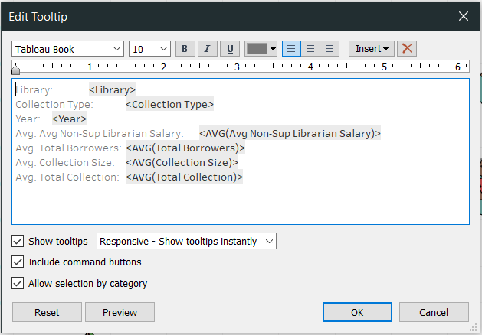
Motion Scatter Chart (cont’d)
Browse under Data & Tools.
Remove “Avg.” from the tooltip field titles as appropriate, and rearrange the text to position it according to importance.
Click the Tooltip box.
Edit the text.
Press OK.
Mouse over a data point once more to review the tooltip.
Save your file.
You now have a motion scatter chart with pie charts!

Slide 31
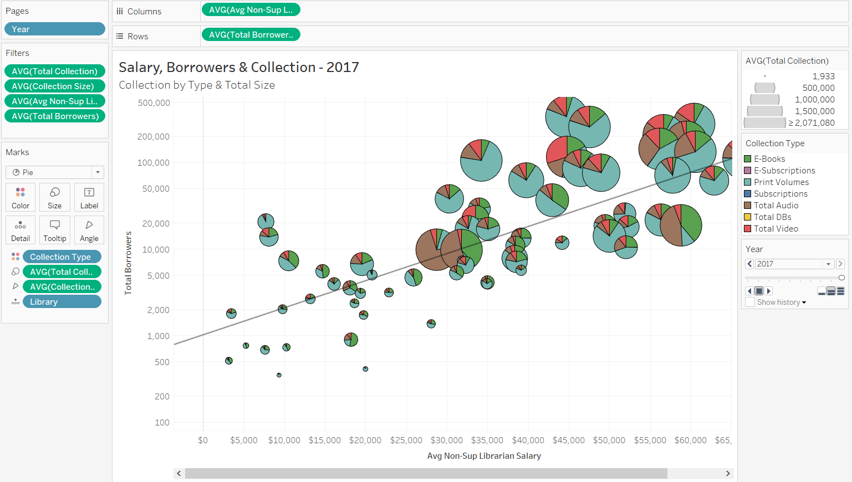
Motion Scatter Chart (cont’d)
A view of the finished motion scatter chart

Slide 32
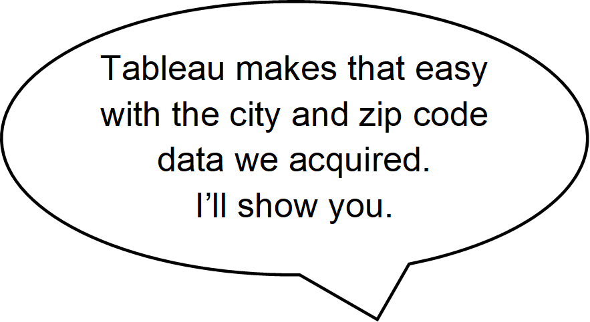
Symbol Map
Create a new worksheet on which to create the map.
Click on the tiny chart with a plus sign icon to the right of your current worksheet at the bottom of the window.
Drag location information to the Columns. Use the zip code for the greatest precision.
In the Show Me chart pane, click the symbol map icon to confirm the type of chart so Tableau will translate your data to coordinates.
Toggle the Show Me pane off.

Slide 33
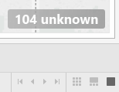
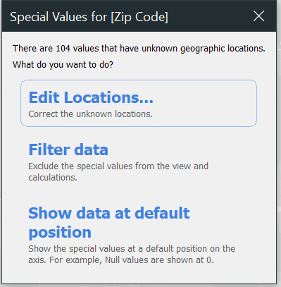
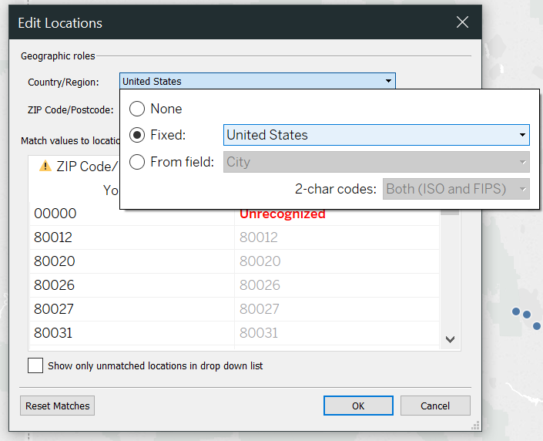
Symbol Map (cont’d)
Browse under Data & Tools.
Only a few library locations are showing, and no cities are labeled. Remedy this with a few steps:
Click on the 104 unknown message at the far bottom right of the window.
Click on the Edit Locations… option from the dialogue box that opens.
Under Geographic roles>>Country/Region, click on the drop down and select the Fixed radio button and United States from its drop down menu.
Note that all but one issue has resolved, and it’s for an invalid 00000 zip code.
OK out, and then take a peek at the data to see which library used this zip code.

Slide 34
Symbol Map (cont’d)
Browse under Data & Tools.
Click on the Data Source tab at the bottom of the window.
Mouse over the Zip Code header.
A sort button appears to the right. Click on it to reverse the sort order.
Drag the Library column border to increase the width so the full name can be seen.
The library name doesn’t explain the invalid zip code, but scrolling across the record reveals that no data was entered for this library at all, so it can be safely filtered out.
Click on Sheet 2.

Slide 35
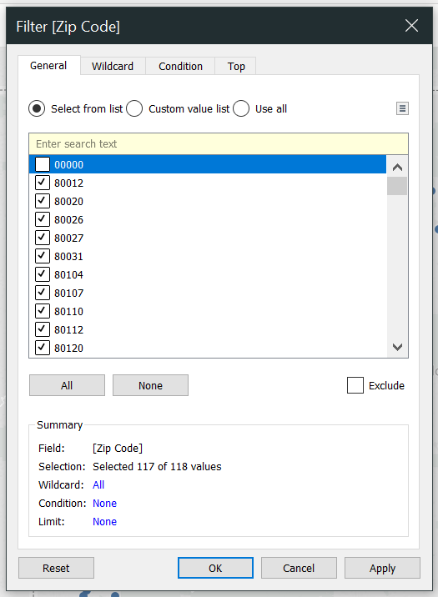
Symbol Map (cont’d)
Browse under Data & Tools.
Click to the right of the Zip Code Detail mark. *See slide 24 for a review.
Choose Filter….
Uncheck the box next to 00000.
Hit OK.

Slide 36
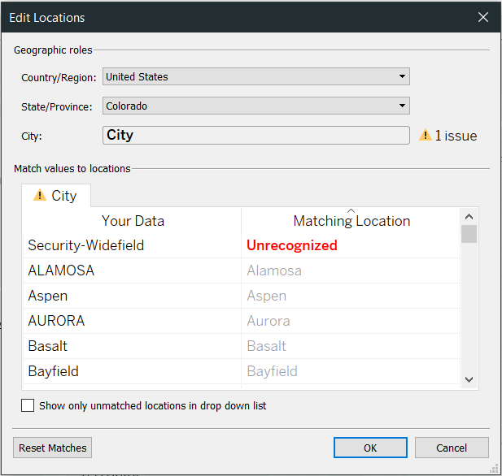
Symbol Map (cont’d)
Browse under Data & Tools.
Drag the City field to the Label box to add in the city names.
Not all cities are labelled, but this will vary with the zoom level.
Once again, location ambiguities must be corrected.
Click the 71 unknown message in the bottom right of the window.
Click Edit Locations….
Select Colorado from the State/Province>>Fixed dropdown.
Security-Widefield is still unrecognized.

Slide 37
Symbol Map (cont’d)
Browse under Data & Tools.
A quick web search for “Security Widefield Colorado public library” reveals that Security is the library name, it serves the Widefield school district, and it is located in Colorado Springs. Therefore, assign the library to a known location.
Click on Unrecognized under Matching Location.
Select Colorado Springs from the dropdown menu.
If you encounter a city for which you cannot determine a recognized location for the unknown data, simply filter it out as you did for zip codes.
OK out.

Slide 38
Symbol Map (cont’d)
Browse under Data & Tools.
A map of the public libraries in Colorado now shows, and it’s time to start adding measurements to the data points, keeping in mind the overall focus of salary.
Drag the average non-supervising librarian salary field out of the Staff folder to the Size box. *See slide 19 for a review.
Change the aggregation method under the mark’s Measure option to Average. *See slide 18 for a review.
Change the size of the circles via the slider accessed through the Size box. *See slide 20 for a review.

Slide 39
Symbol Map (cont’d)
Browse under Data & Tools.
Choose a dimension which might be correlated with salary to differentiate the data points by color. For this tutorial, use the legal basis—the type of library.
Drag Legal Basis to the Color box. *See slide 21 for a review.
To better differentiate the data points, add a border to them.
Click the Color box and select a color from the Effects>>Border dropdown.

Slide 40
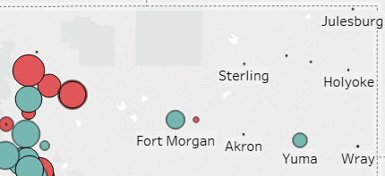
Symbol Map (cont’d)
Browse under Data & Tools.
At this point you can see that some data points are just dots. These are probably libraries which did not report salary data and can be filtered out.
Click to the right of the salary Mark field. *See slide 24 for a review.
Choose Filter….
Click the At least button.
Set the value to 1.
OK out.

Slide 41
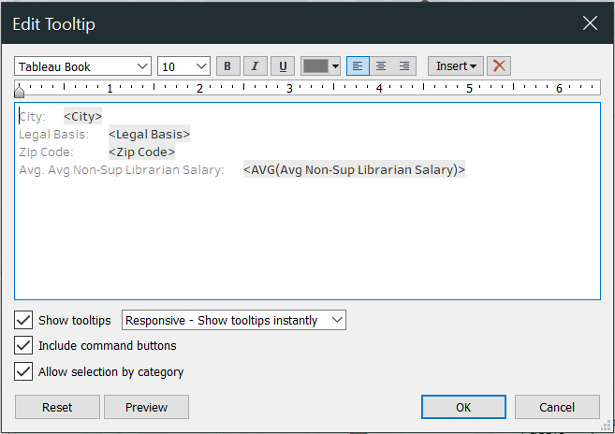
Symbol Map (cont’d)
Browse under Data & Tools.
A few display details need to be improved for conciseness and clarity.
Remove “Avg.” from the tooltip field title, and rearrange the text to position it according to importance.
Click the Tooltip box.
Edit the text.
Press OK.
Mouse over a data point to double check how the tooltip now displays.

Slide 42
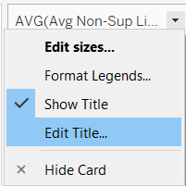
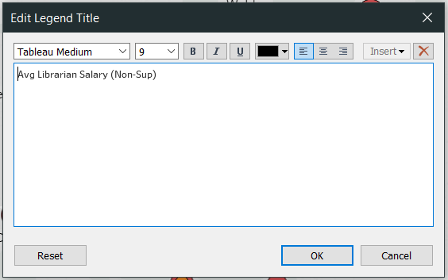
Symbol Map (cont’d)
Browse under Data & Tools.
Clean up the title in the legend to move the important information to the front so it fits in the legend window and push the non-essential information to the end where it is still available.
Click to the right of the legend title.
Choose Edit Title….
In the text box alter the title.
OK out.

Slide 43
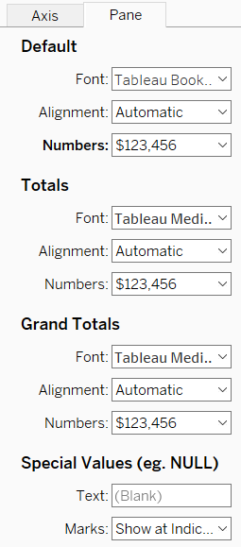
Symbol Map (cont’d)
Browse under Data & Tools.
In the tooltip, the salaries show no currency symbol, so format that field.
Click to the right of the salary Mark field. * See slide 28 for a review.
Select Format….
The axis doesn’t show in this chart, so we won’t need the Axis tab this time.
Click the Pane tab.
Choose Currency (custom) from the Numbers dropdown under Default.
To conserve space, change the number of decimal places to 0.
Click out of the dialog box.

Slide 44
Symbol Map (cont’d)
Browse under Data & Tools.
Double click the sheet name to rename it using a concise title that will still clearly inform you which worksheet is which. *See slide 27 for a review.
Right click on the chart title to rename it.
Choose Edit Title….
In the text box type a concise title which also explains to the users what the chart is showing them. Maintain consistency across charts with bolding and font size.
Hit OK.
Your map is ready to go!

Slide 45
Symbol Map (cont’d)
A view of the finished symbol map

Slide 46
Line Chart
Once again, create a new worksheet on which to create the chart. *See slide 32 for a review.
Our line chart will show change in salaries by required education level across time, so our axes will be for salary and year.
Drag Year to the Columns.
Drag the salary field to the Rows.
In the Show Me chart pane, click the first line chart.
Toggle the Show Me pane off.
Change the aggregation type of the salary field to Average. *See slide 18 for a review.

Slide 47
Line Chart (cont’d)
Browse under Data & Tools.
Drag the MLS field to the Color Mark box. *See slide 21 for a review.
Filter out invalid MLS values, just as you did for salary info with the scatter motion chart, but this time uncheck the boxes next to invalid values. *See slide 24 for a review.
Hit OK.

Slide 48
Line Chart (cont’d)
Browse under Data & Tools.
Let’s clean up the salary display before proceeding.
Format the field for the Axis and Pane. *See slides 28-29 for a review.
Edit the axis title. *See slide 23 for a review.

Slide 49
Line Chart (cont’d)
Browse under Data & Tools.
We also need to remove empty and 0 value salaries so they are not averaged into the output. For this, we must filter not via the averaged Row salary, but via another instance of the salary field used just for filtering.
Drag the salary field from the Data pane into the Filter pane (known as a Shelf Card in Tableau).
Choose All values from the ensuing dialog box.
Hit Next.
Filter for values which are at least 1. *See slide 24 for a review.

Slide 50
Line Chart (cont’d)
Browse under Data & Tools.
Let’s add a little more detail by setting the line size to vary by the count of libraries matching the criteria in a given segment.
Drag Library to the Size Mark box.
Wow! What a mess! We need to consolidate the lines into just one for each MLS status.
Right click on the Library mark you just added.
Choose Measure>>Count (Distinct).
Adjust the line size just as you did for circles and pie charts. *See slide 20 for a review.

Slide 51
Line Chart (cont’d)
Browse under Data & Tools.
We have just a few pieces to tidy up before we finish.
Rename the MLS legend title for conciseness. *See slide 42 for a review.
Hide the CNTD(Library) Legend.
Click to the right of the legend title.
Click on Hide Card.
Edit tooltip labels. *See slide 30 for a review.

Slide 52
Line Chart (cont’d)
Browse under Data & Tools.
Edit the year axis to eliminate wasted space. *See slide 23 for a review.
From the Edit Axis [Year] dialog box, click on the Fixed radio button.
Change the Fixed start and Fixed end text fields to the actual start and end values of the data.
X out.

Slide 53
Line Chart (cont’d)
Browse under Data & Tools.
Rename the worksheet. *See slide 27 for a review.
Edit the chart title. *See slide 27 for a review.
Save.
You now have a line chart!

Slide 54
Line Chart (cont’d)
A view of the finished line chart

Slide 55
Dashboard
That sounds awesome!
At the most basic level, creating a dashboard is easy.
Click on the New Dashboard grid icon from the bottom tabs.
Drag the worksheets you already created to the right pane.

Slide 56
Dashboard (cont’d)
Browse under Data & Tools.
Next, ensure that when a data point is clicked on one chart, it is highlighted on the other charts. Note: This only works for fields which are common to each chart.
From the toolbar at the top, click on the highlighter icon.
Select All Fields.

Slide 57
Dashboard (cont’d)
Browse under Data & Tools.
As you can see, corrections to this quick and easy dashboard are needed to make it visually sound. This applies not just to the layout, but also to the consistency of visual cues between the worksheets on the dashboard.

Slide 58
Dashboard (cont’d)
Browse under Data & Tools.
Let’s start by addressing the basic layout so you can see those visual cues.
In the Dashboard pane, click on the dropdown below Size.
Click the dropdown arrow to the right of Fixed size.
Select Automatic. This allows Tableau to resize to match the screen size.
Click on the Floating button at the bottom of the Dashboard pane under Objects. This will let us to independently resize objects and move them out of the fixed grid.

Slide 59
Dashboard (cont’d)
Browse under Data & Tools.
Before we start refining the formatting, consider whether all the worksheets should be included on the dashboard. To be included, a chart should be clear to understand within the context of the dashboard.
In our dashboard, clicking on a point in the line chart only highlights the data point in the scatter chart if it happens to be showing the same year; it does not advance the scatter chart to that year. At a glance, it seems like the scatter chart has no corresponding data points, which could confuse the viewer. The map chart also does not sync, but this can be corrected by adding Year to the Pages shelf. The line chart, however, specifically shows change over time and cannot be so easily correct. As it stands, this disconnect undermines the ease and efficiency of reading the visualization, so remove the line chart from the dashboard.

Slide 60
Dashboard (cont’d)
Browse under Data & Tools.
Click the line chart.
Click the X at the top corner (it may be on the right or left side).
Now consider the scatter chart.
The size of the circles draws the attention, shifting it to the collection size they represent and away from salary. The pie charts themselves, with all the information they display, overload the dashboard. Also, the same colors are used in the pie chart as in the map, but they mean different things, which can further confuse the viewer.
To be the most efficient and easiest to understand, size and color—two primary visual cues—should be consistent between charts so viewers don’t have to remember different associations for the same visual cue. Anything more involved should be developed through a story, building from easy to hard to train the viewers.

Slide 61
Dashboard (cont’d)
Browse under Data & Tools.
To implement this strategy, duplicate the existing scatter chart (so you still have the collection visualization for reference), and modify it.
Right click the scatter chart tab at the bottom of the window.
Select Duplicate.
Rename the new worksheet to clarify that it is the one with pie charts.
Click on the original worksheet tab. Note: We’re modifying not the duplicate but the original worksheet to maintain its connection in the dashboard.

Slide 62
Dashboard (cont’d)
Browse under Data & Tools.
Change the Marks to Circle. *See slide 18 for a review.
Remove the Collection Type Color Marks field and the collection size (type-specific as opposed to total collection) Detail Marks field.
Right click the field.
Select Remove.
Drag Legal Basis to the Color Marks box. *See slide 21 for a review.
Swap the collection size and salary fields by dragging them from their shelves to each other’s shelves.

Slide 63
Dashboard (cont’d)
Browse under Data & Tools.
As we can now see, the range of the collection size is too vast for a linear axis scale.
Change the x-axis to a logarithmic scale. *See slide 23 for a review.
A good deal of wasted white space now precedes our data points.
From the Edit Axis… dialog box, uncheck Include zero. *See slide 23 for a review.
From Trend Line Options, remove the extra trend lines so only that for year shows. *See slide 26 for a review.
Set the Model type to Power.

Slide 64
Dashboard (cont’d)
Browse under Data & Tools.
A few things need to be cleaned up.
Edit the axis title. *See slide 23 for a review.
Edit the chart title. *See slide 27 for a review.
Edit the legend title. *See slide 42 for a review.
Edit the tooltip to remove unnecessary aggregate terms and to rearrange fields in order of importance. *See slide 30 for a review.
Mouse over a data point to double check the tooltip.

Slide 65
Dashboard (cont’d)
Browse under Data & Tools.
As mentioned previously, we need to page the years for the map and configure it to link to the scatter chart.
Click on the map worksheet tab.
Drag Year to the Pages shelf. *See slide 25 for a review.
Now we’ll coordinate the data point sizes, using the map sizing, as the scatter chart sizes would be too large for the map.
Switch to the map worksheet.
Go to Edit sizes… from the size legend. *See slide 20 for a review.

Slide 66
Dashboard (cont’d)
Browse under Data & Tools.
Grab a piece of paper and a soft-tip marker. (Tableau offers insufficient options to do this precisely in the program.)
Hold the paper up to your screen so that the edge aligns with the left border of the dialog box.
Make a mark at the edge of the paper where the inner border of the right slider is.
Cancel out.
Add Library to the Detail Mark box so both charts have the same details and will highlight each other when a data point is clicked. *See slide 19 for a review.

Slide 67
Dashboard (cont’d)
Browse under Data & Tools.
Switch to the scatter chart.
Go to Edit sizes… from the size legend. *See slide 20 for a review.
Hold the paper up to your screen so that the edge aligns with the left border of the dialog box.
Adjust the slider so the inner border is directly above the mark on the paper.
OK out.

Slide 68
Dashboard (cont’d)
Browse under Data & Tools.
Our dashboard now uses visual cues consistently, so let’s move on to the finer details of the layout. Start by removing the chart titles to eliminate their redundant text, and plan on adding a dashboard title to provide overall information, and captions to note chart-specific descriptions.
Right click a chart title.
Select Hide Title.
Now, resize the map to eliminate the wasted space on either side, and then reposition it.
In the left pane, click on the Layout tab.
Check the box next to Floating.
Under Position, set x to 920 and y to 110.
Under Size, set w to 590 and h to 500.

Slide 69
Dashboard (cont’d)
Browse under Data & Tools.
Let’s also delineate our objects.
Click the arrow to the right of Border.
Select the solid line, and change its color to a light gray which won’t draw the eye but will still lend a subtle border.
Repeat the steps for the scatter chart and legends. Note: The dimensions you use will vary according to your screen size, as Tableau does not offer the option to set size and position by percentage to take advantage of the automatic sizing when floating objects. Suggested layout settings:
Object | x | y | w | h
Scatter chart | 0 | 110 | 910 | 500
Year legend | 0 | 620 | 650 | 80
Salary legend | 660 | 620 | 250 | 80
Legal basis legend | 920 | 620 | 590 | 80

Slide 70
Dashboard (cont’d)
Browse under Data & Tools.
With the color legend’s shorter size, the column widths need to be adjusted.
Hover the cursor to the left of the third column until a double-sided arrow and a dashed line appear.
Drag the arrow until the full text of each library basis shows.
Note: Tableau does not allow each column to be independently sized. The size you select applies to every column.

Slide 71
Dashboard (cont’d)
Browse under Data & Tools.
We now have room for a dashboard title.
Click on Dashboard in the menu bar.
Select Show Title.
Right click on the title.
Choose Edit Title.
Edit the title just as you did for chart titles. *See slide 27 for a review.

Slide 72
Dashboard (cont’d)
Browse under Data & Tools.
Add the chart caption.
Click on a chart.
Click the arrow in the top corner. The arrow may be on either the right or left side.
Select Caption.
The caption by default is quite verbose. Make it succinct.
Right click on the caption.
Select Edit caption….
Modify the caption as you would a chart title. *See slide 27 for a review.

Slide 73
Dashboard (cont’d)
Browse under Data & Tools.
Unfortunately, Tableau does not facilitate the inclusion of the currently viewed year in the dashboard title, so we’ll include it in the captions.
Click on the Insert dropdown.
Choose Page Name.

Slide 74
Dashboard (cont’d)
Browse under Data & Tools.
Now the map caption is too stark and should be formatted to draw less attention.
Right click on the caption.
Select Format caption....
From the Format Title and Caption pane which appears to the left, under Caption, choose a light gray from the Shading dropdown.
X out.

Slide 75
Dashboard (cont’d)
Browse under Data & Tools.
While the map is still selected, click on Background from the Layout pane on the left.
Select the same light gray.
Rename the dashboard sheet. *See slide 27 for a review.
You now have a dashboard! Give it a whirl!

Slide 76
Dashboard (cont’d)
A view of the finished dashboard

Slide 77
PDF
Now that I have all these amazing, informative charts, how can I share them?
Tableau offers several options to share visualizations, but each is at the expense of budget or privacy.
Tableau Server is really for larger organizations with the budget and staff to manage a server and warrant collaboration.
Tableau Online is available at a cost.
Embedded Analytics is available at a cost.
Tableau Public is free, but the visualizations are public, which would not be suitable for anything an organization may wish to keep private.

Slide 78
PDF (cont’d)
Browse under Data & Tools.
The simplest way to share your visualizations is to print them to PDF so you can distribute them via email, intranet, website, etc. Note: This method only produces a static copy.
Let’s print a PDF of our dashboard for the latest year.
Mouse to the Year legend.
Click on the dropdown arrow.
Select 2017.

Slide 79
PDF (cont’d)
Browse under Data & Tools.
We will also focus on city libraries in the Boulder and Denver area.
Click on City in the Legal Basis legend.
Recenter the map.
Click the arrow in the mouse-over control panel.
Select the perpendicular arrows.
Pan to the area of interest.
Zoom and pan again until the map shows the level of detail you wish to see.

Slide 80
PDF (cont’d)
Browse under Data & Tools.
Click in the Dashboard pane to the left to unselect all objects.
Click on File.
Select Print to PDF….
The default options will suit our needs, so hit OK.
Select the location where you wish to save the PDF.
Name the file.
Hit OK.
You now have a PDF and can email this to your supervisors along with your insights.

Slide 81
PDF (cont’d)
A view of the finished PDF

